Slide 1
Digital Summit 2019 Forever Young Business Compiling Based On Micro Service
GCT / Digital / Shanghai / Dalian
Meng Qingsong
Dec. 25, 2019

Slide 2
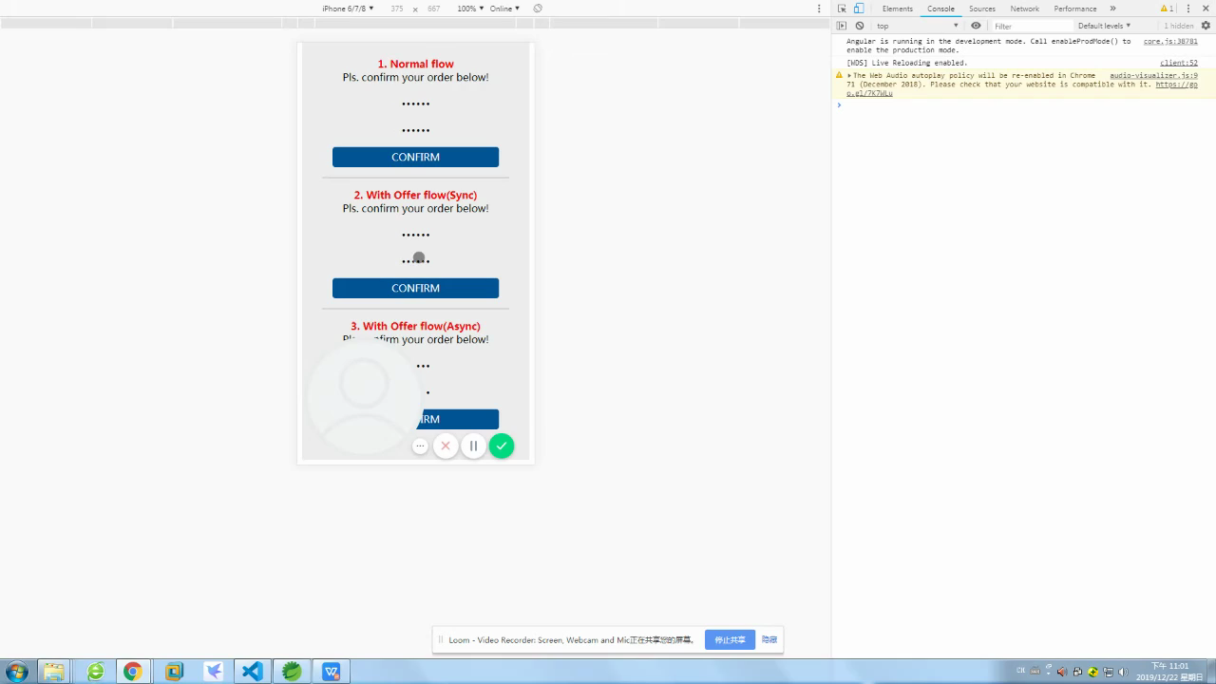
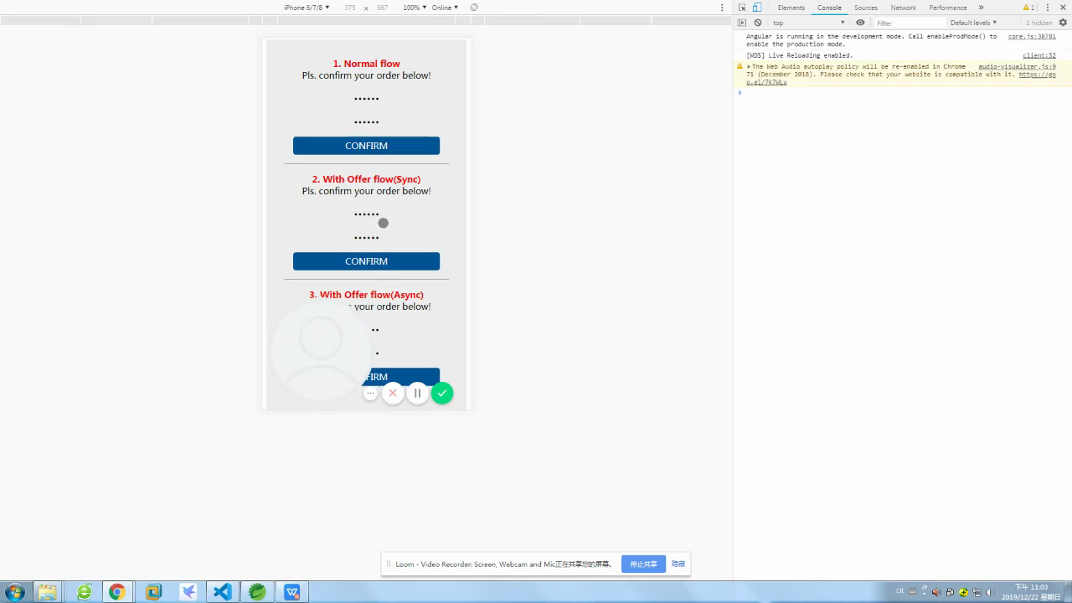
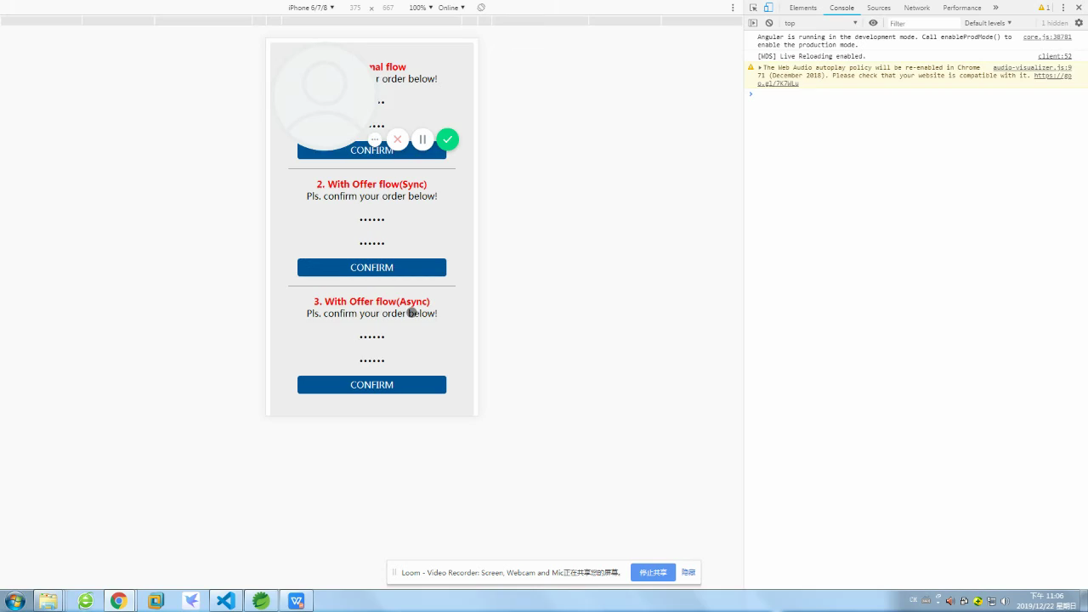
Video
This demo is used to simulate the trasaction confirm operation. After click the "CONFIRM" button we will record the submit time.
For demo #1, we will only send a confirmation email to customer after they submitted the order.
For demo #2, we will synchronously update offer after they submitted the order, then send mail.
For demo #3, we will perform an asynchronous offer updating after they submitted the order, then send mail.

Slide 3
Agenda
Compare tranditional MVC structure and Micro Service Architecture.
Divided micro services based on domain, using Time Deposit as reference.
Domain Events.
Code implements.

Slide 4
Layered Structure Based On MVC
ASDP
Micro Service Structure
In BAU, we only divide TD into diff sub apps based on functionality, and deal with the same business within every sub-function repeatedly.
Even worse, this case will spread to App service and Action due to nonstandard coding. The whole function seems in a mess.
TDAction
UI/AccountController
All business of a function handled in domain service at the beginning of design.
TDService(App/Domain)
AccountAppService
AccountDomainService
Later on, the business becomes more an more complex. We have so many dependencies for each business.
GDTO
GDTO
Only one domain business
TDPersistence
AccountRepository
At last, if we change one business logic, we might also need to change other business in this function. If many functions have the same business, we need to change for all functions synchronously.
JAXB
Soap/API
Infrastructure

Slide 5
Micro Services Based On DDD
C
A
C
Client
Adapter
C
A
A
Account Service
Time Deposit Service
Interest Rate Service
C
A
A
A
A
Email
SMS
Customer Service
FX Rate Service
?

Slide 6
Domain Events
functionEntered
●
●
Sync
sendEmail
●
depositBooked
Sync
createTDAccount
Sync
sendSMS
●
●
●
●
Sync
?
●
●
?

Slide 7
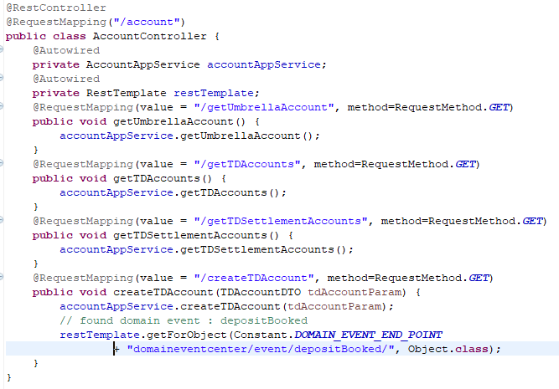
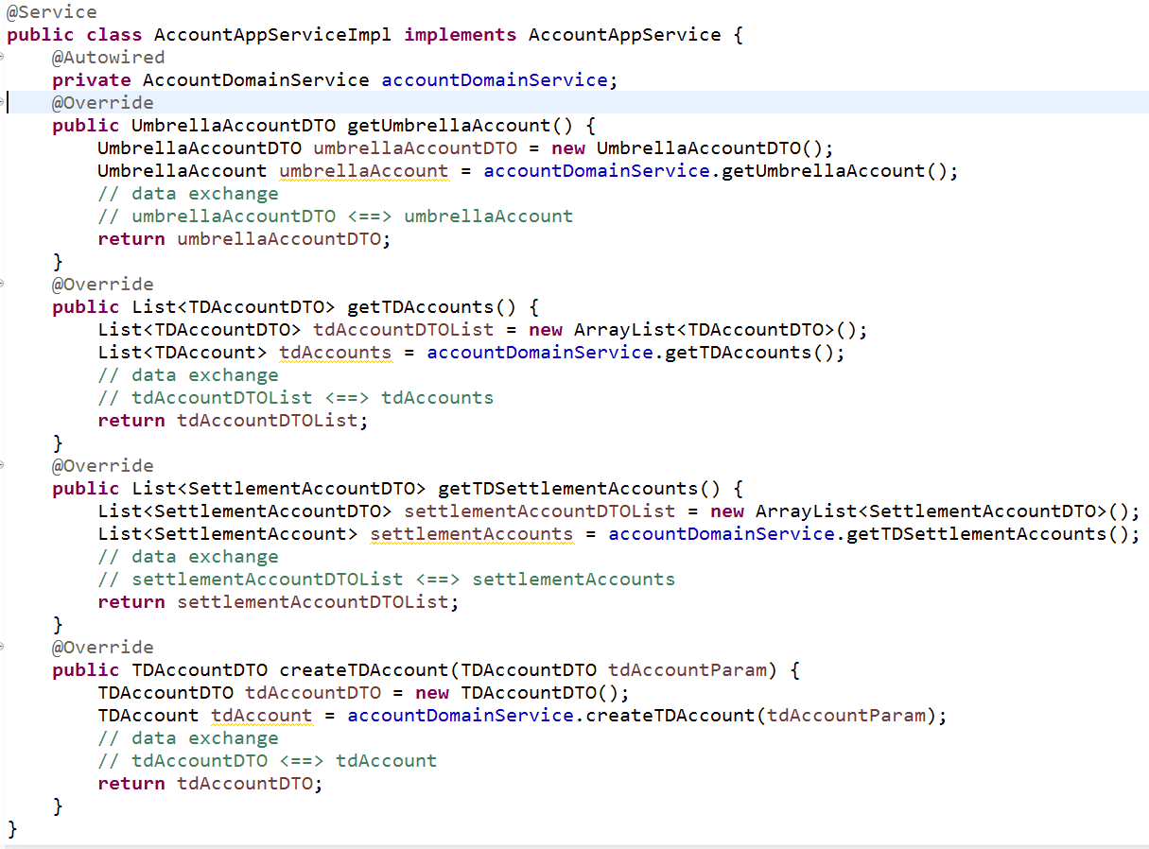
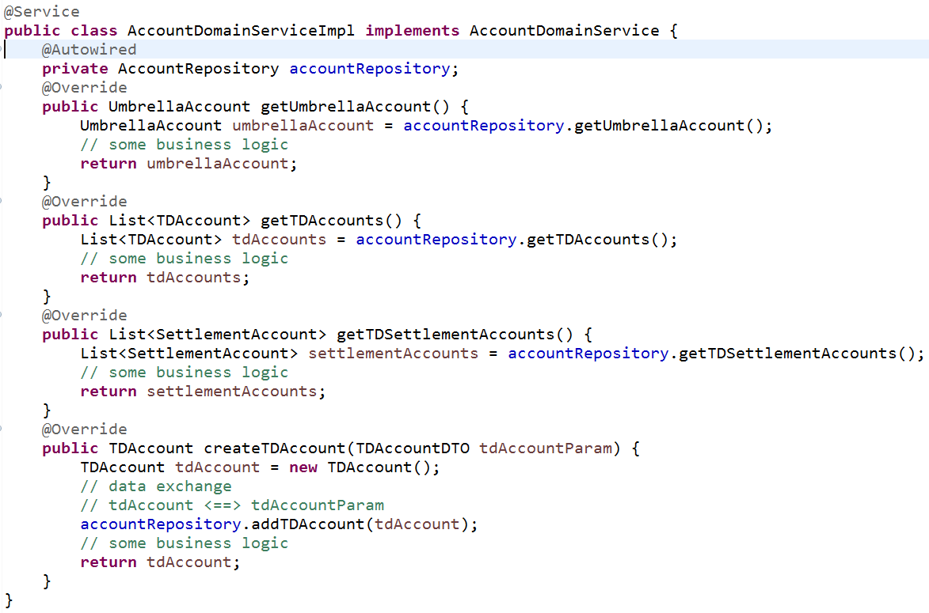
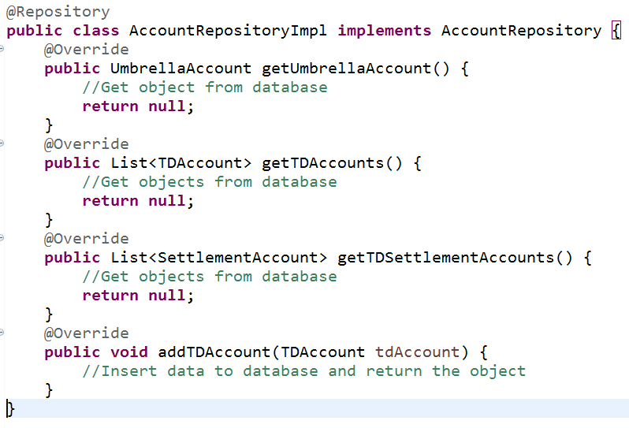
Code Implements -- Account Domain
UI/Controller
App Service
DomainService
Repository

Slide 8
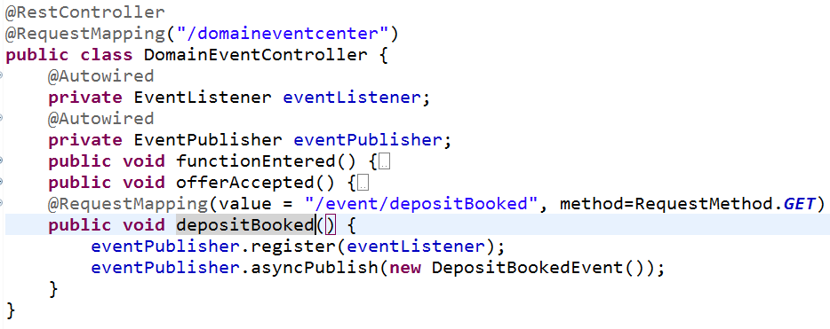
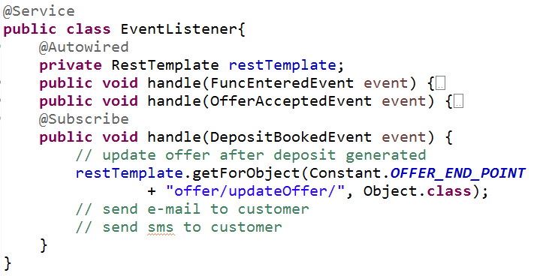
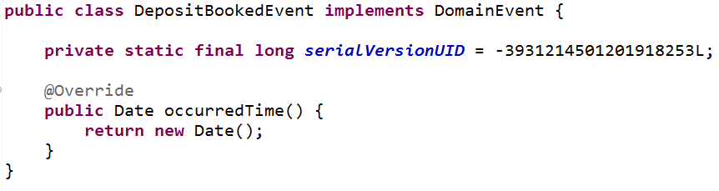
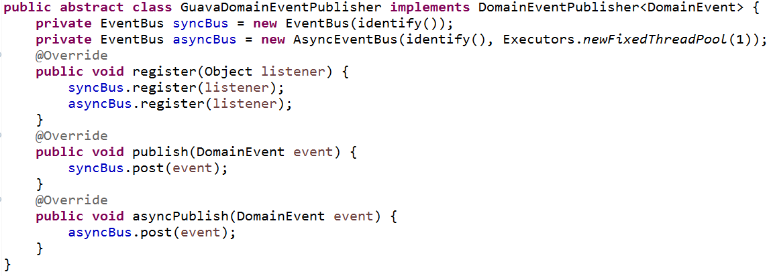
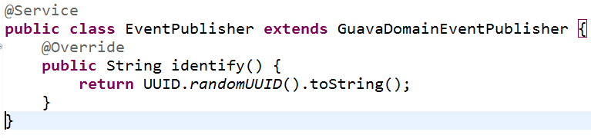
Code Implements -- Domain Events Center
EventController
restTemplate.getForObject(Constant.DOMAIN_EVENT_END_POINT + "domaineventcenter/event/depositBooked/", Object.class);
Subscriber
Subject Type

Slide 9
THANK
GCT / Digital / Shanghai / Dalian
YOU

